Slide 1
Confidence Interval

Slide 2

Example 1
What is the basis of your decision? How confident are you?

Slide 3
Example 2
CNR DG is interested in average checking of students grades for all modules opted by students in CNR. A random sample of 100 students is selected to represent average of all the grades to be used in annual report.
What level of confidence for the mean is the DG going to be satisfied with?
What ± interval number is going to be acceptable?

Slide 4
Sample to population: need to generalize to whole population
Estimate population mean μ however to determine population mean is not always possible to find so, sample mean should be used.
Find a range of values, L < μ < U, within what you think you are confident, that your sample mean contains the population mean (μ).
Such range of values, that you are confident that your sample mean contains the population mean, is called a “confidence interval.”

Slide 5
Confidence Intervals: Example
For example, 18% of women, aged 18-24, think they are overweight.
The “margin of error” is 5%, so the “confidence interval” is written as 18% ± 5%.
This means that we are confident that at least between 13% and 23% of women, aged 18-24, think they are overweight.

Slide 6
General form of Confidence Intervals
Sample estimate ± margin of error
Lower limit L = estimate - margin of error
Upper limit U = estimate + margin of error
It means that one can be confident that the population value is located somewhere between L and U.

Slide 7
Confidence Interval and Standard Error of the Mean (SEM)
To find SEM two things are required:
Population Standard deviation, and
Sample size
Most of the time population standard deviation is not known so it is estimated.
For any population standard deviation, increasing sample size (upto a point) reduces the error.
Similalry Confidence Interval is also affected by Standard deviation, Sample size and Confidence level.

Slide 8
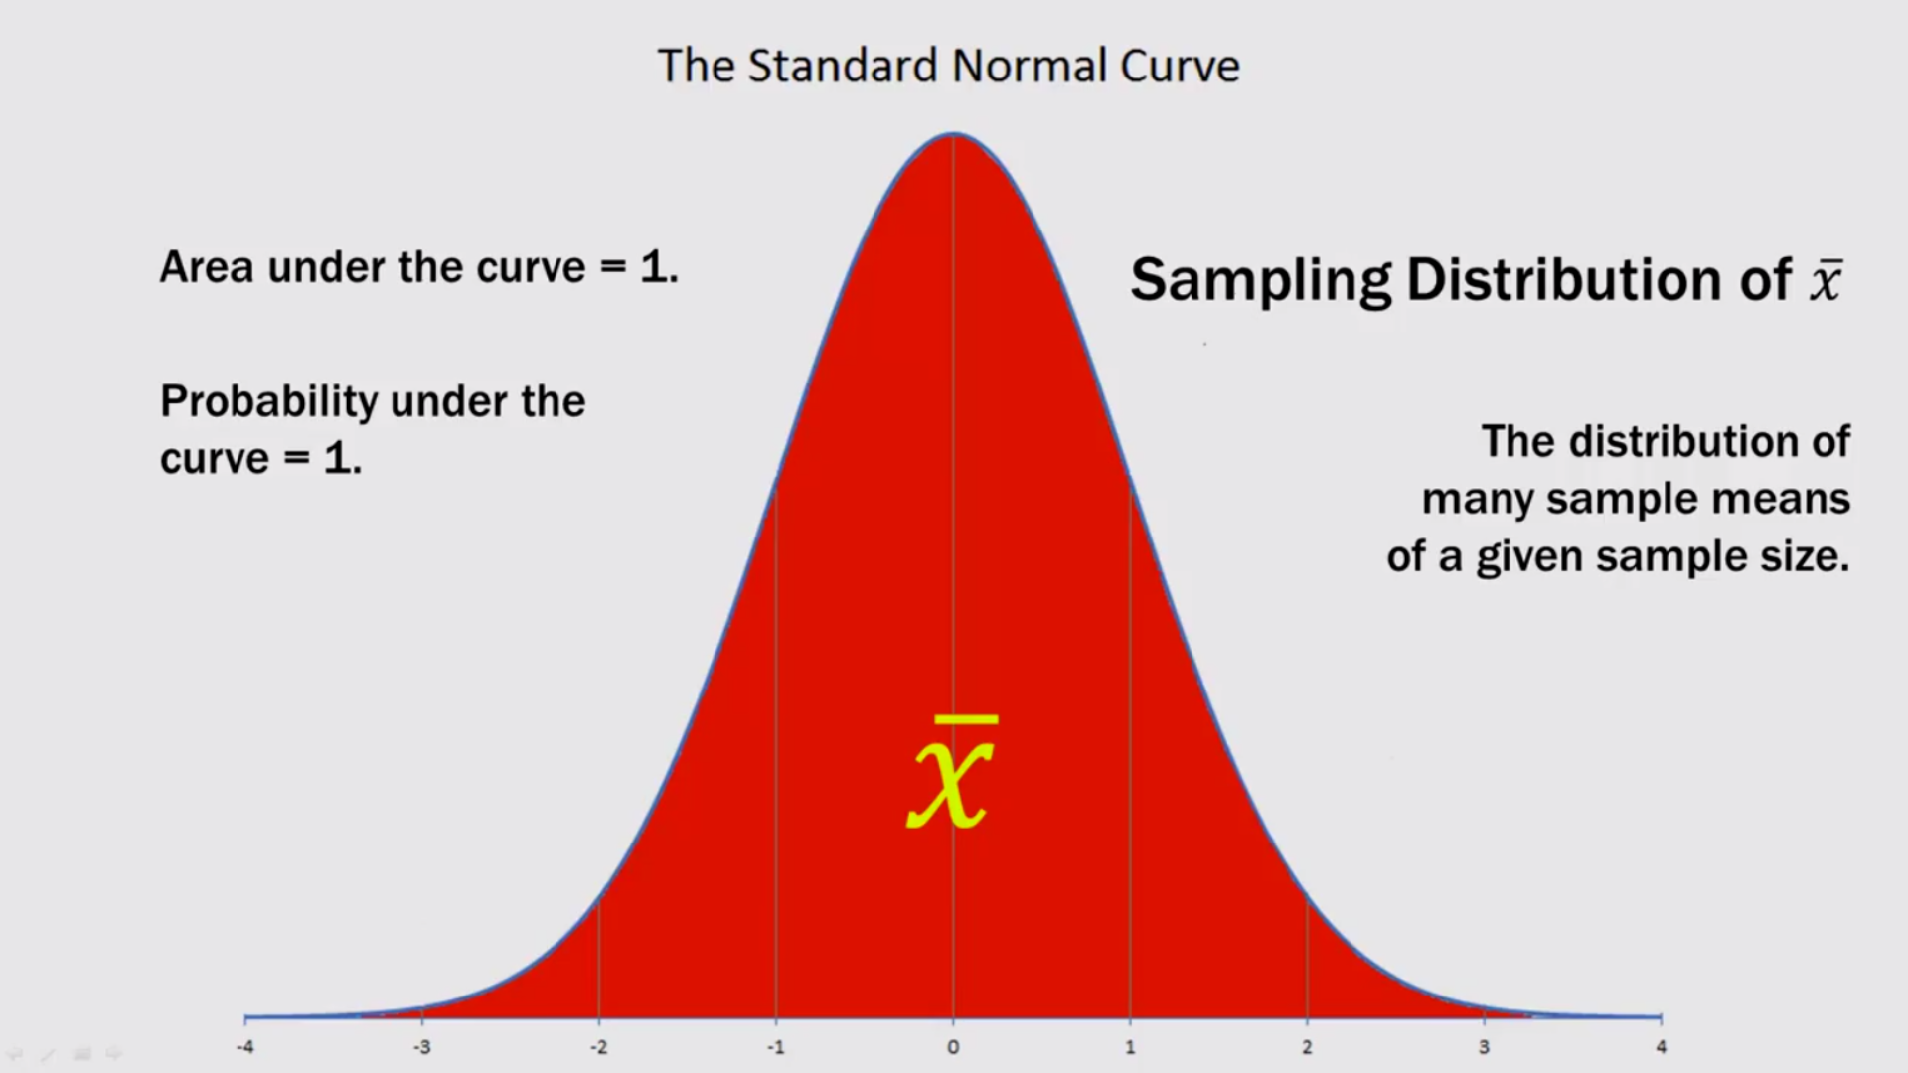
Sampling distribution

Slide 9
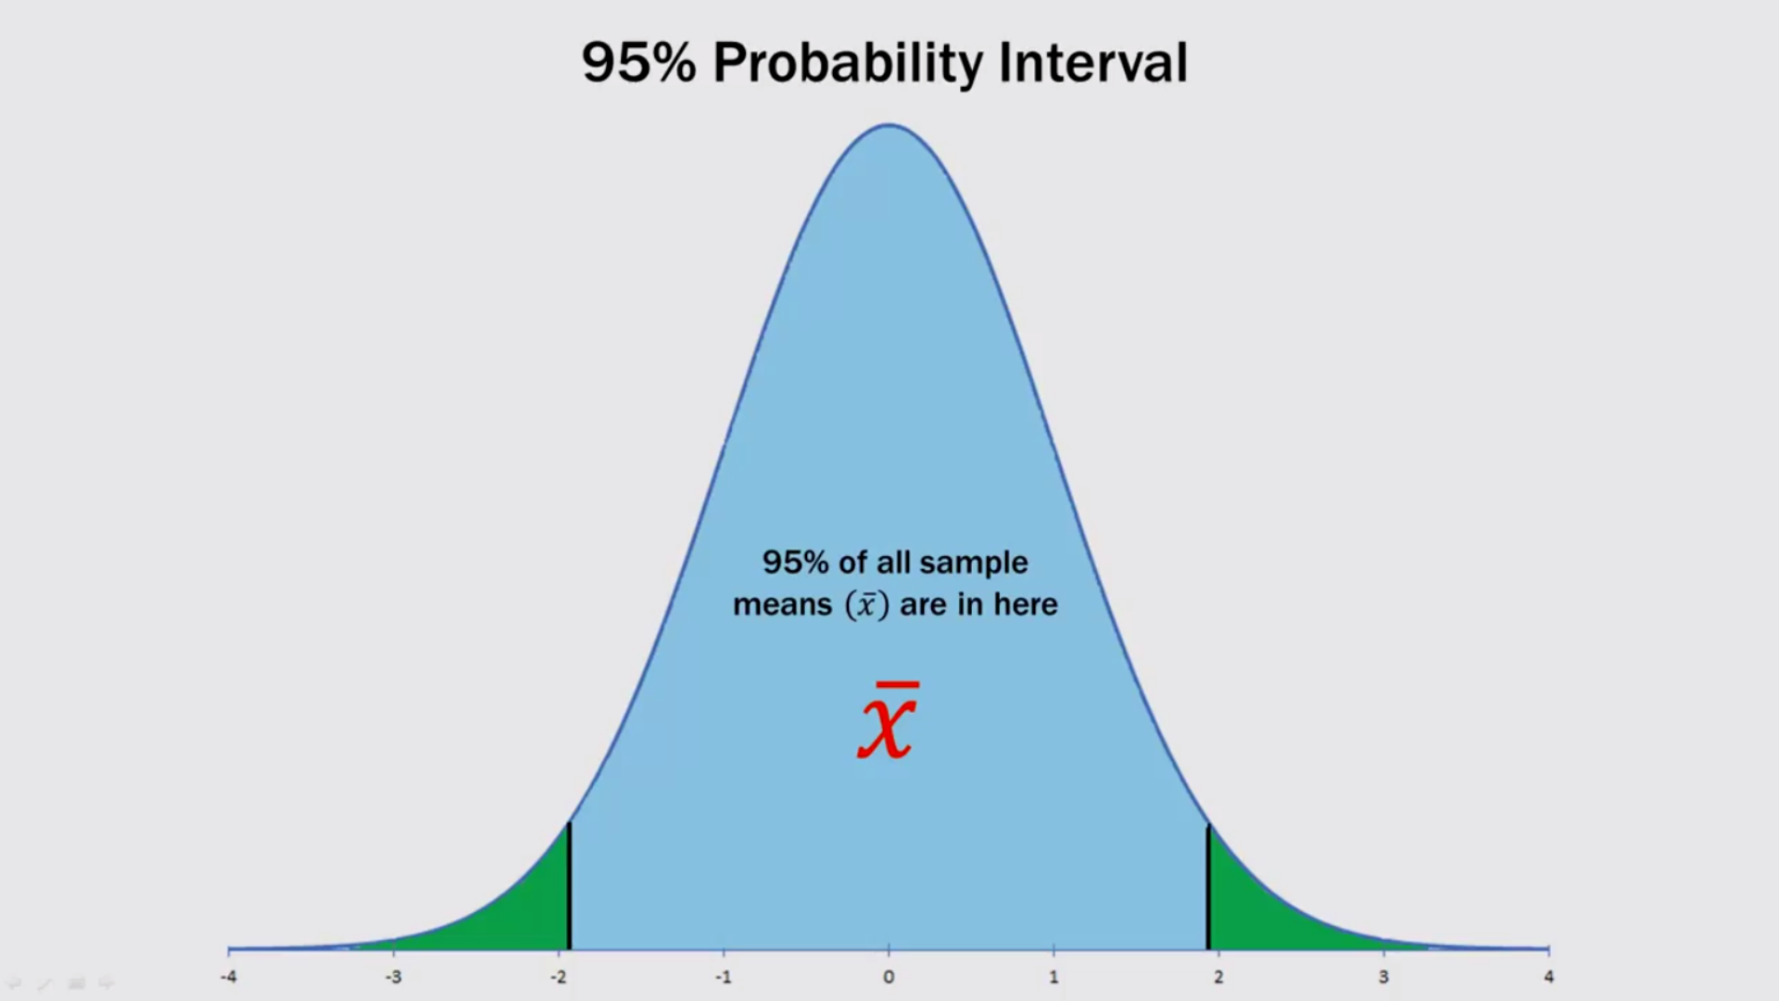

Slide 10
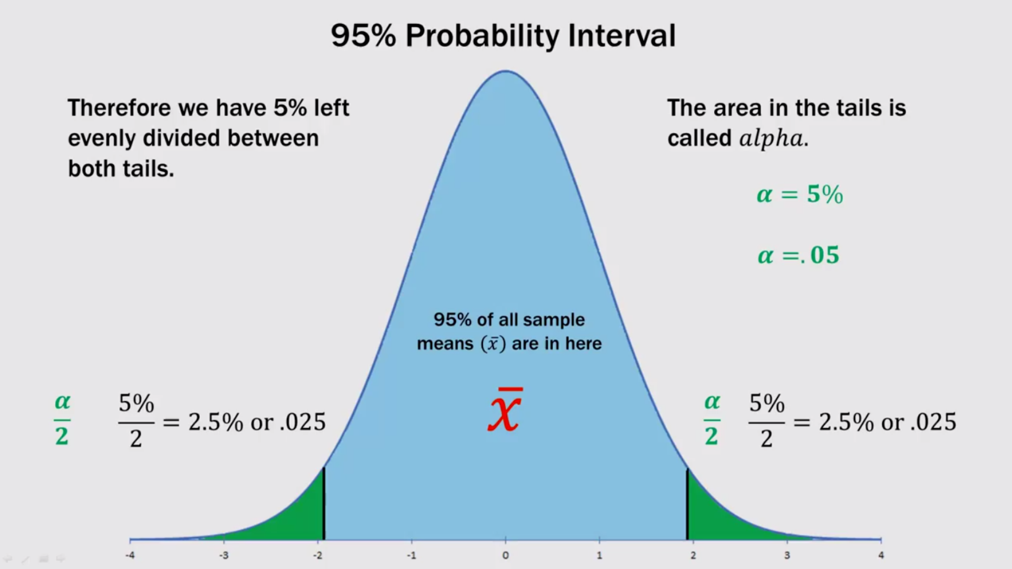
Alpha level or confidence limits (the upper and lower boundary)

Slide 11
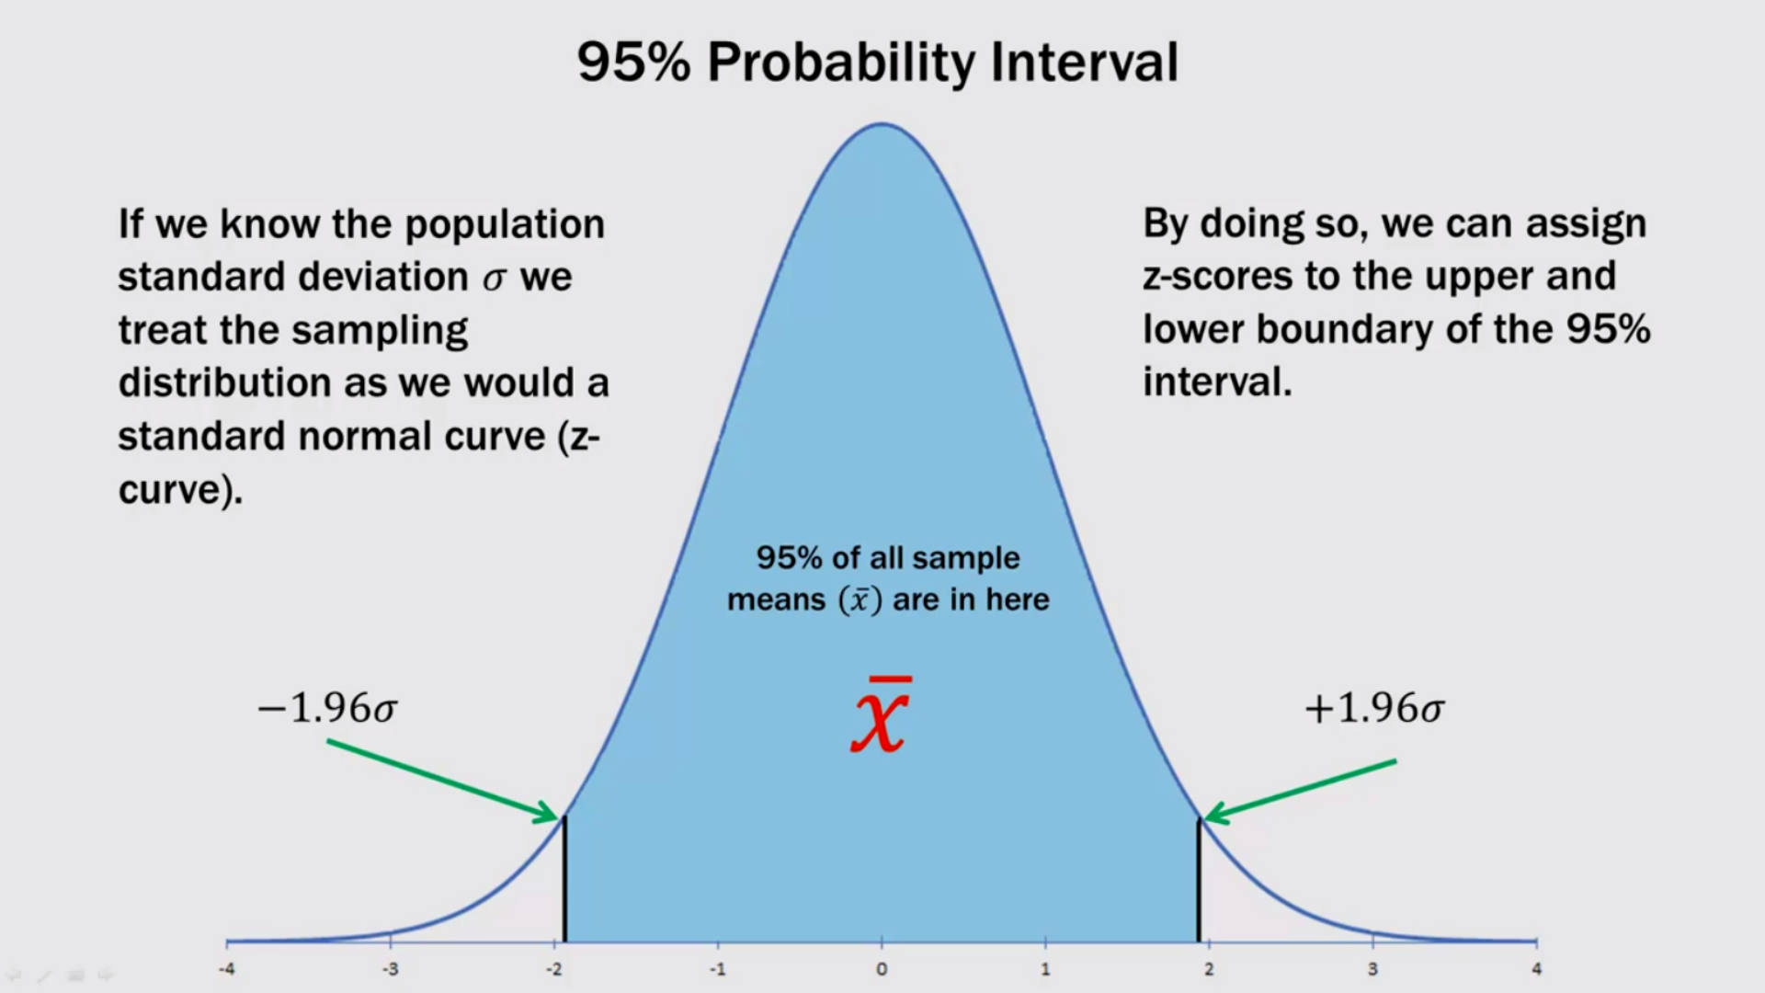
The Value of alpha (1.96)

Slide 12
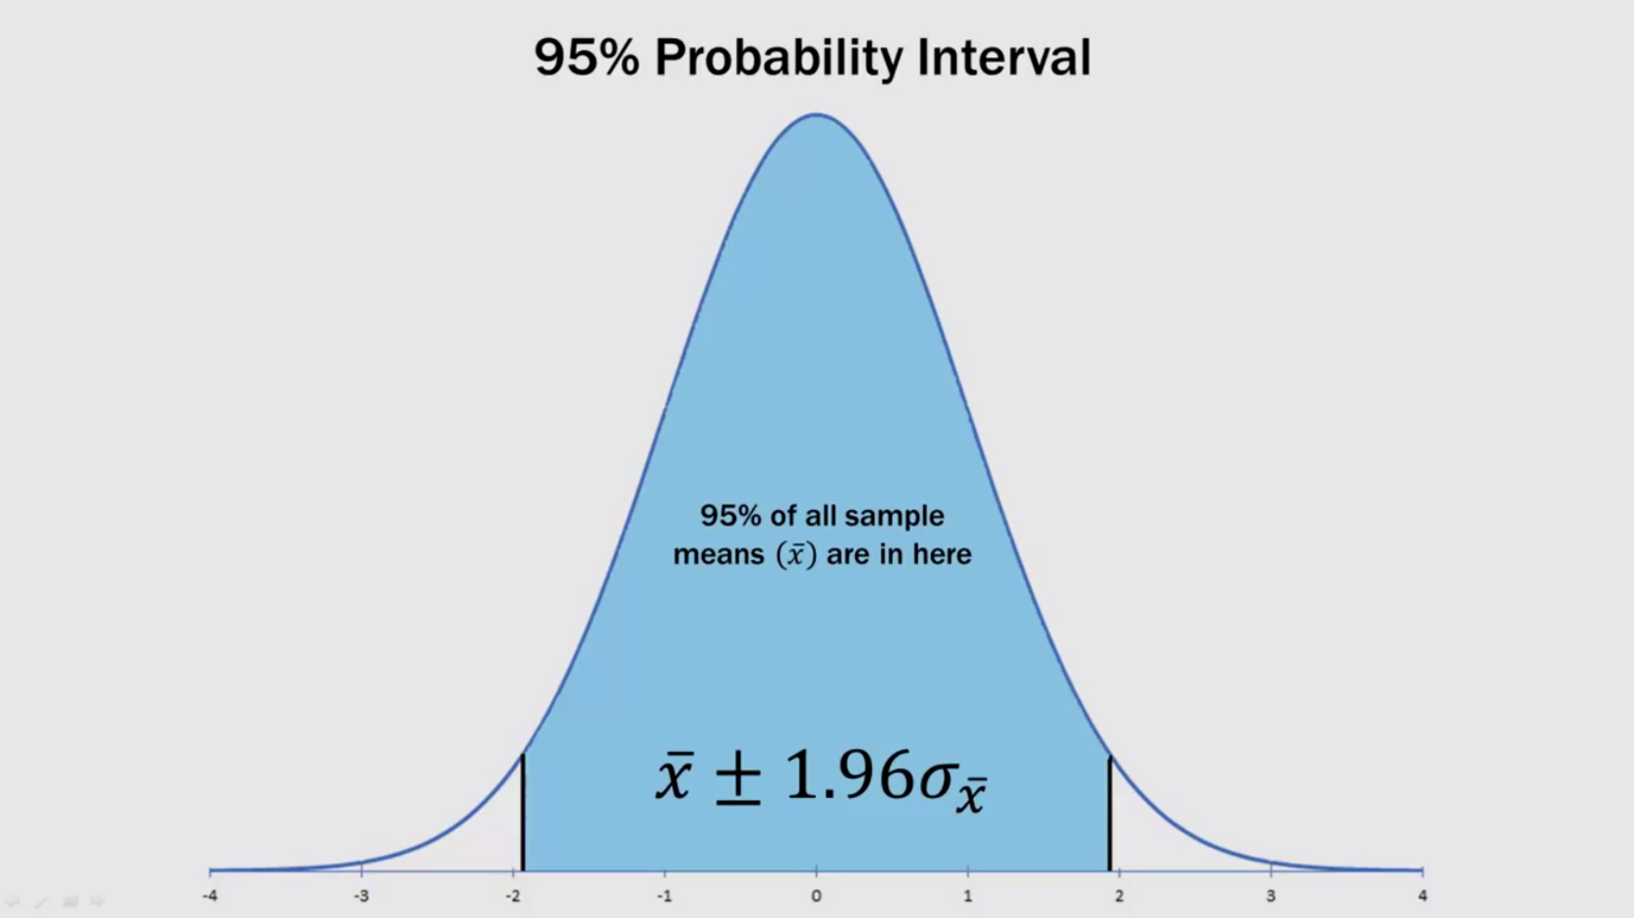
Confidence Interval = Point Estimate (mean) ± 1.96σ$\frac{}{x}$

Slide 13
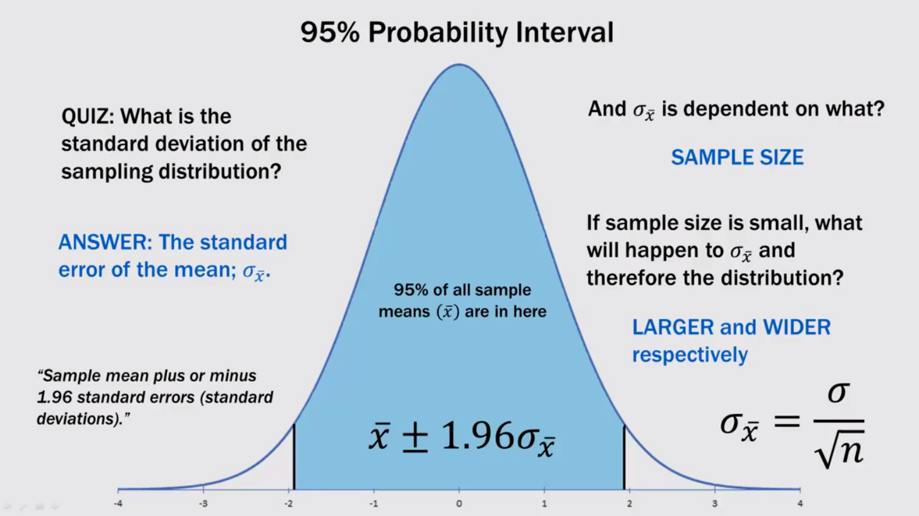
95% probability Interval

Slide 14
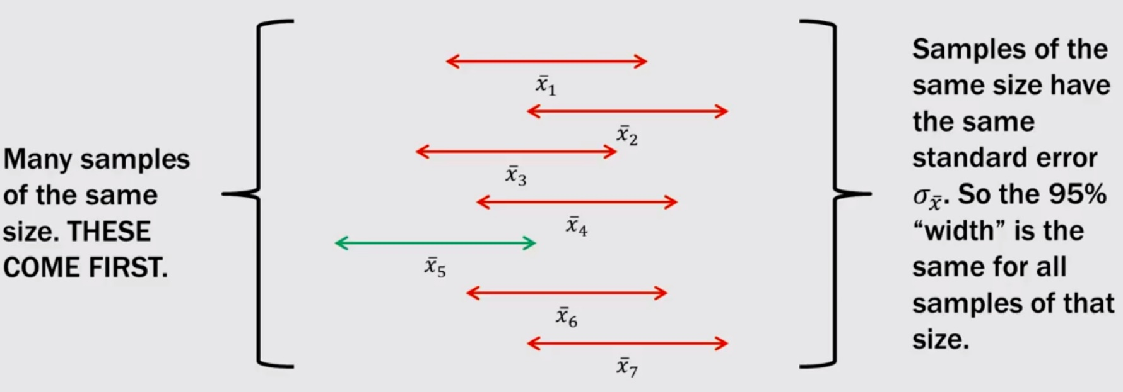
Distribution of sample means (Sampling distribution)

Slide 15
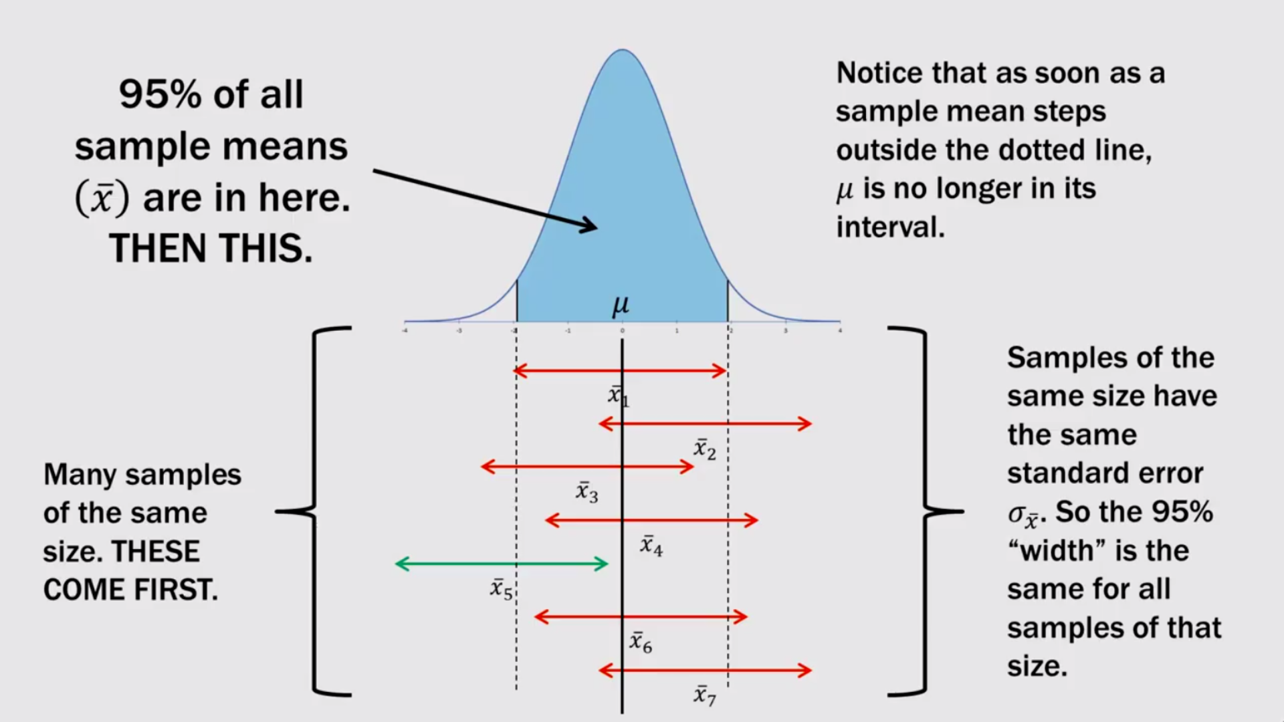
Sampling distribution

Slide 16
Example 3
To estimate the mean amount spent per customer at CNR wet canteen, data was collected for 75 students randomly chosen. Assume that population standard deviation is Nu. 4.
At 95% confidence level, what is the margin of error?
If the sample mean is Nu. 20, what is the 95% confidence interval for the population (for students) mean?

Slide 17
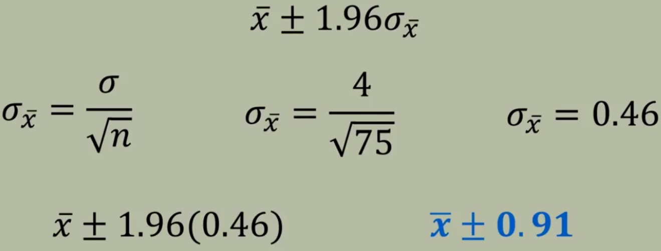
1. At 95% confidence level, what is the margin of error?
Point Estimate ± Margin of error;
If the sample mean is Nu. 20, what is the 95% confidence interval for the population (for students) mean? = 20±0.91

Slide 18
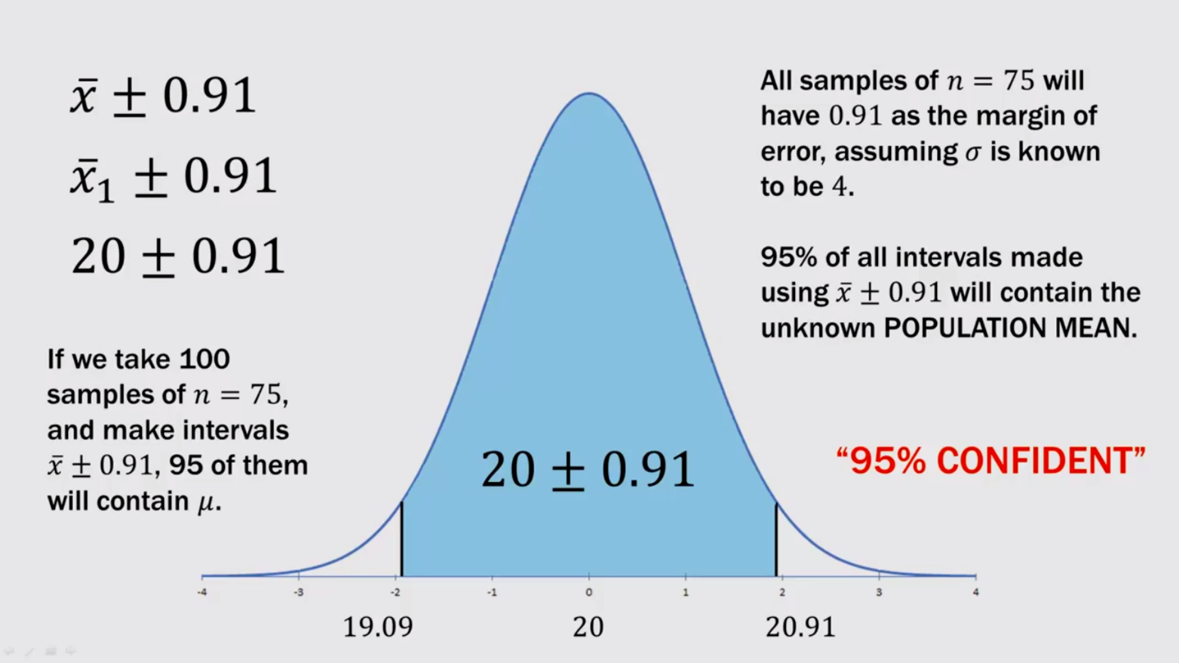
Confidence Interval = 19.09 – 20.91 (to be 95% confident)

Slide 19
Key point
When population standard deviation (σ) is known, it is then used to find the confidence interval.
When population standard deviation (σ) is not known t-distribution is used.

Slide 20
Example 2
To estimate the mean amount spent per customer at a certain tea shop in Wangdue, data was collected for 15 customers. The sample standard deviation (s)was Nu. 4.
At 95% confidence, what is the margin of error?
If the sample mean is Nu. 20, what is the 95% confidence interval for the population mean?

Slide 21
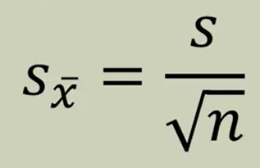
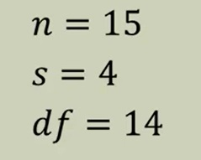
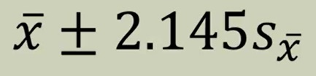
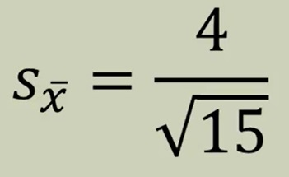
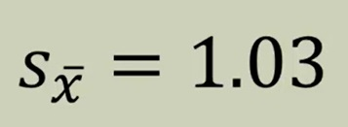
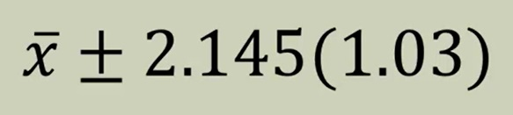
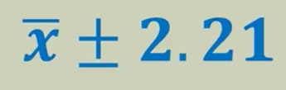
At 95% confidence, what is the margin of error?
Point estimate
Margin of error

Slide 22
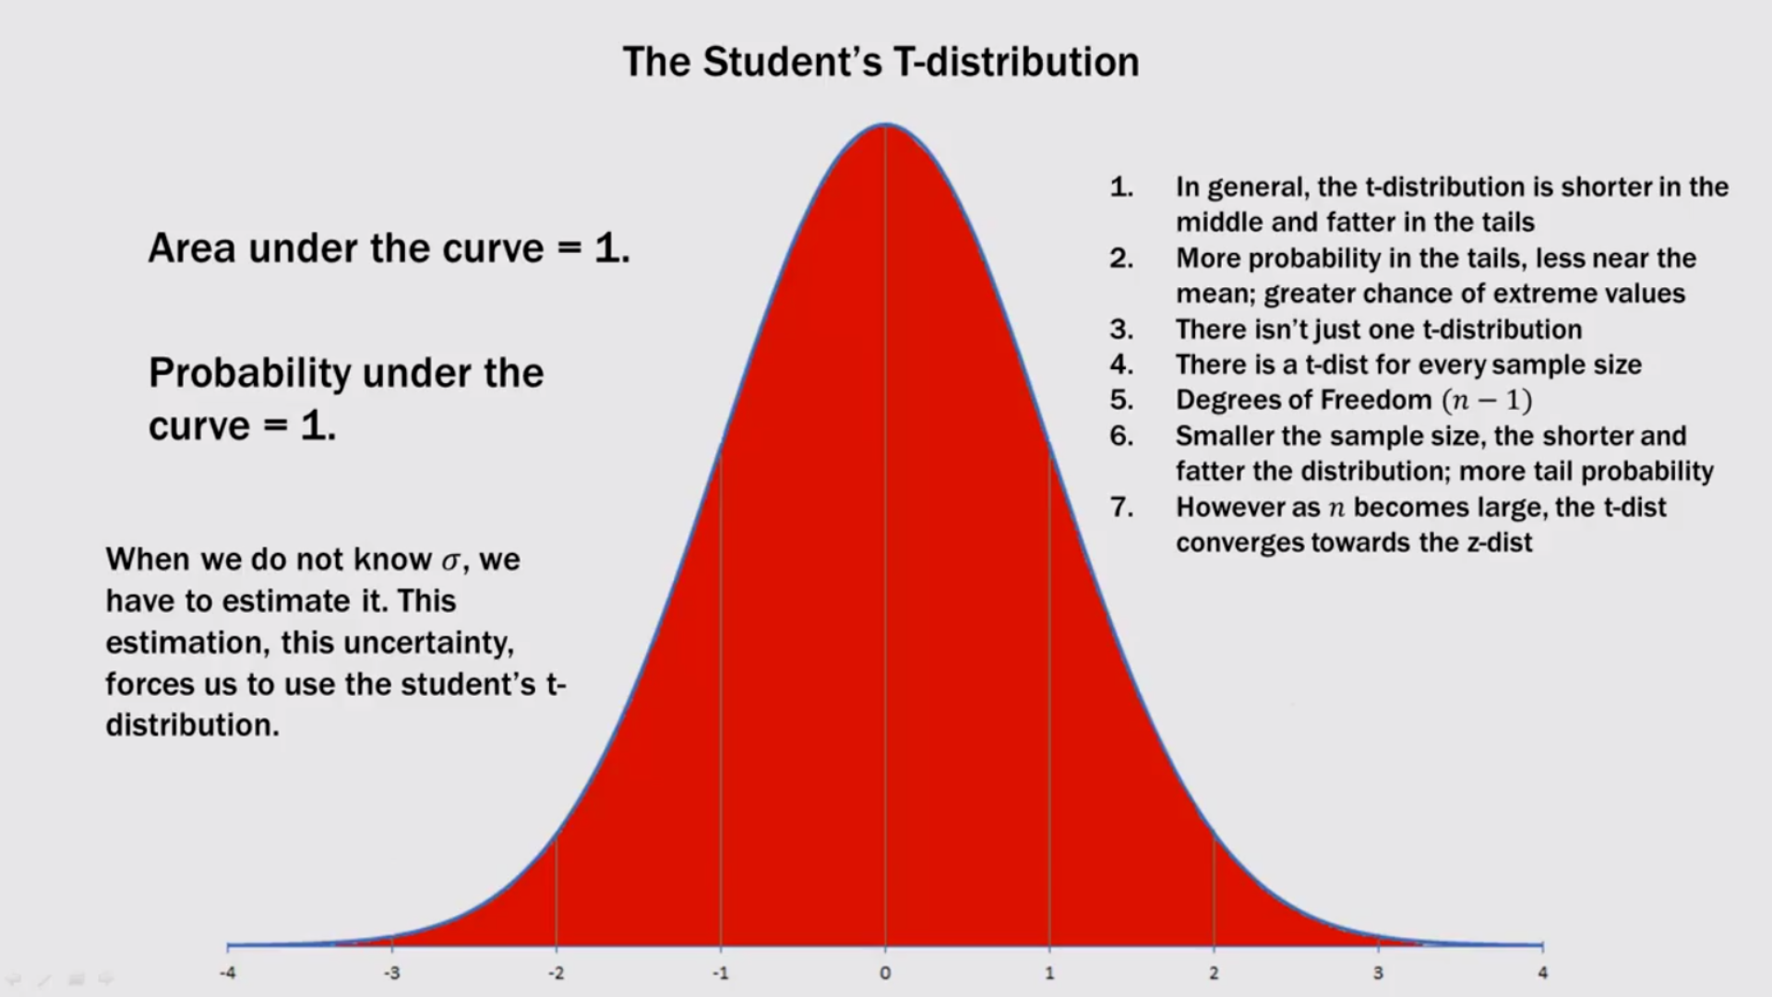
Student’s t- distribution: when the population standard deviation is not known (uncertain about population)

Slide 23
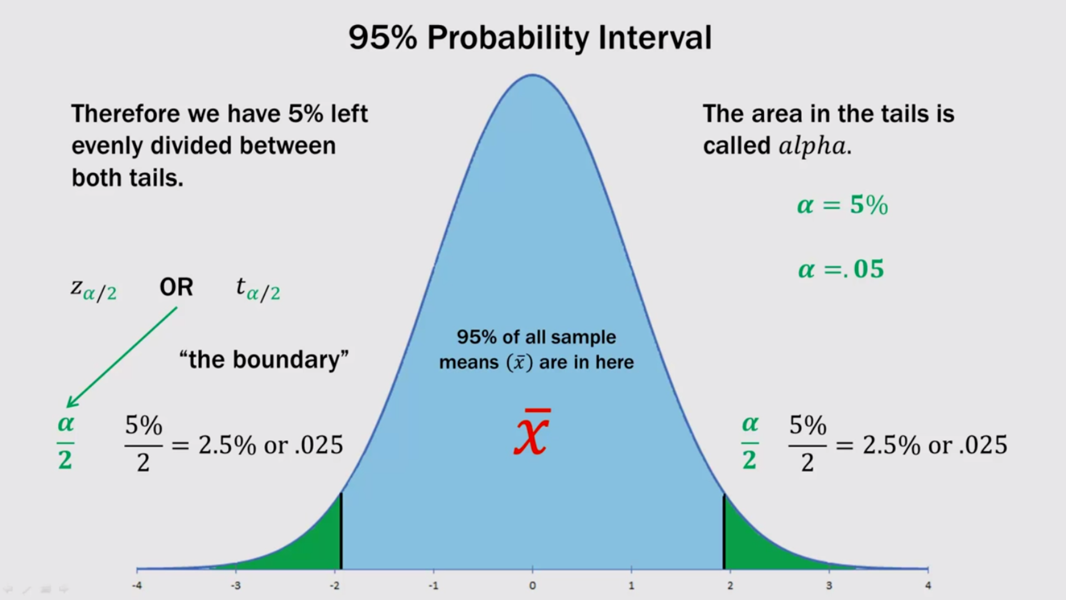

Slide 24
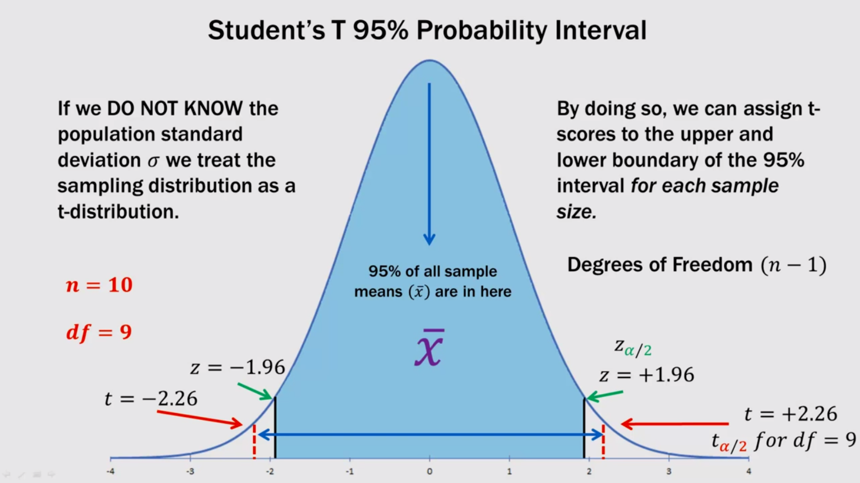

Slide 25
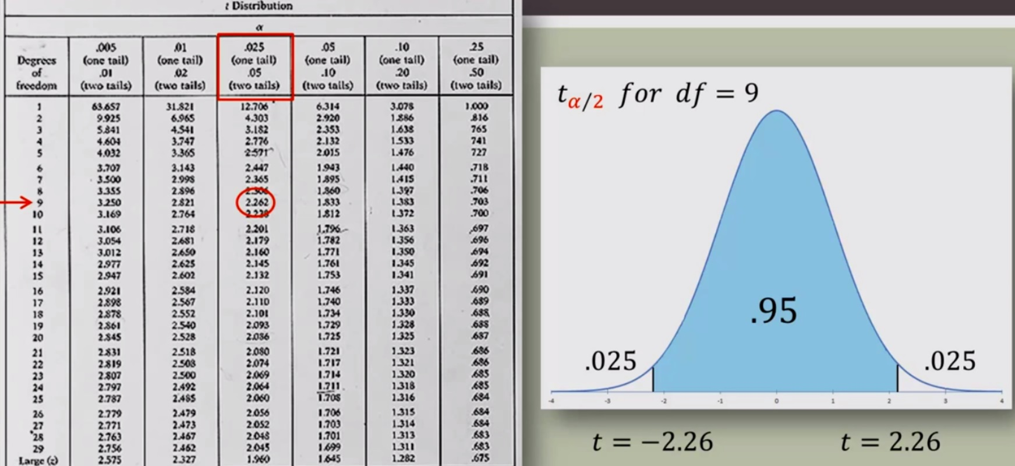
z distribution and student’s t distribution in a normal curve

Slide 26
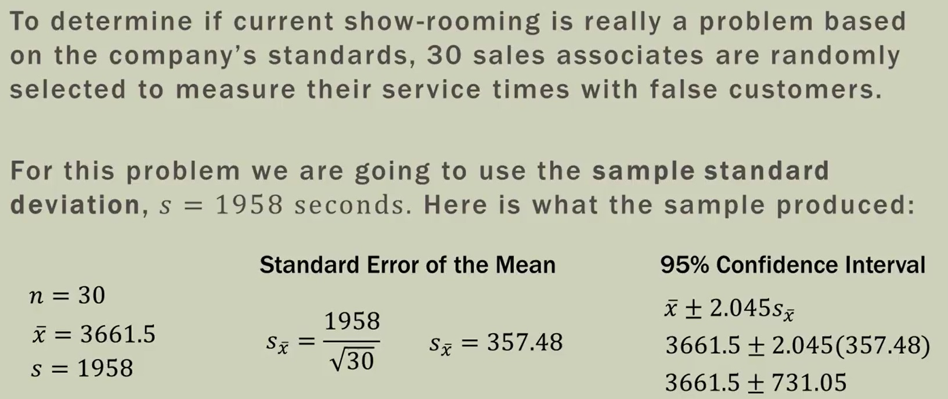
Example 3

Slide 27
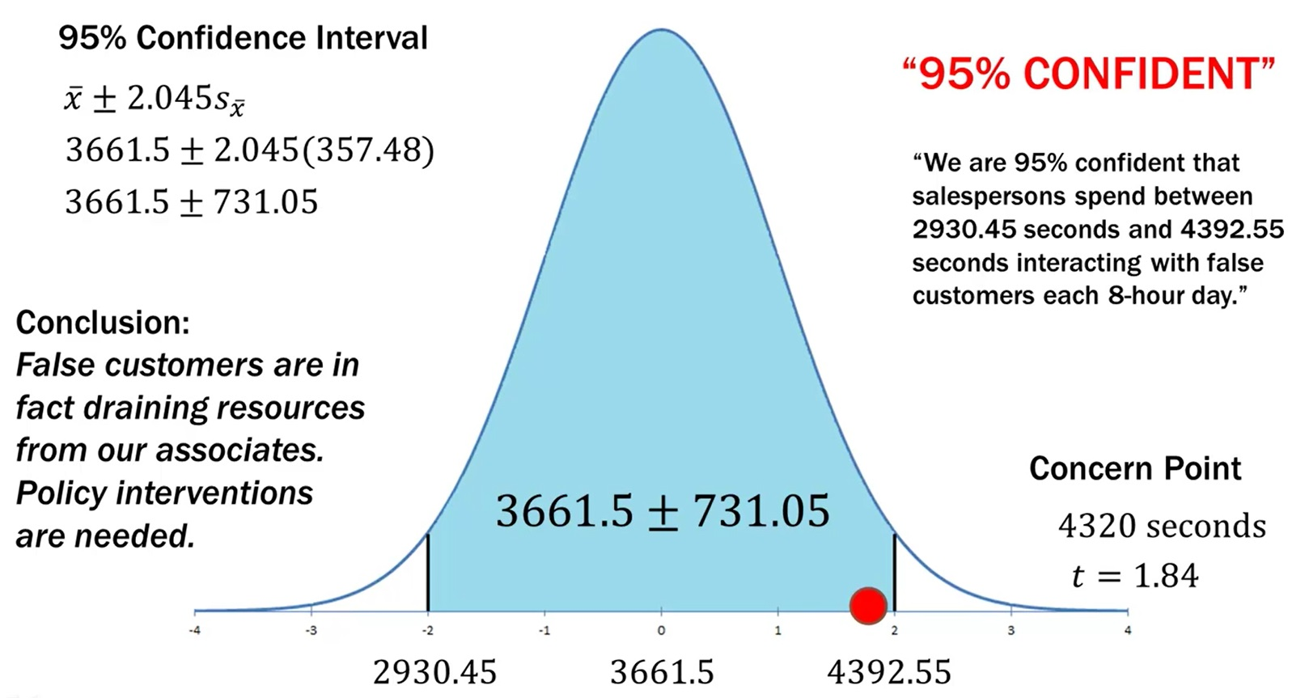

Slide 28
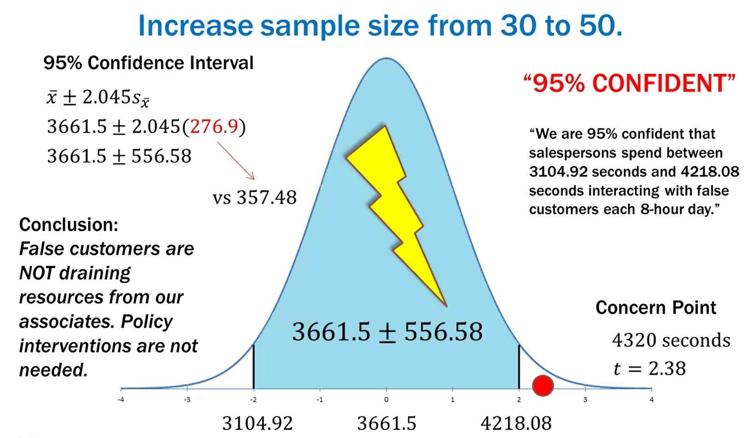

Slide 29
